Slide 1

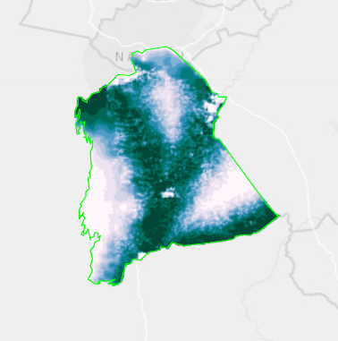
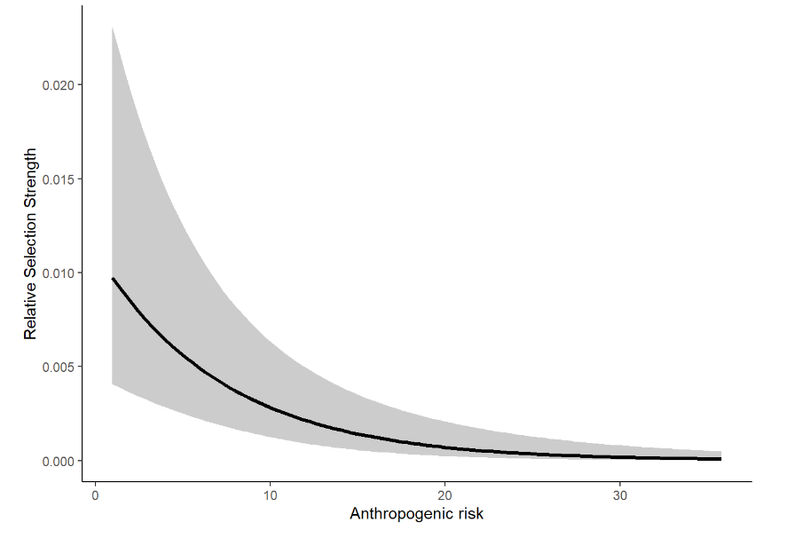
Introduction to Animal Movement Analyses
Resource Selection Function Models
Jared A. Stabach, PhD
Research Ecologist
Terrestrial Lead – Movement of Life Initiative
Conservation Ecology Center
Smithsonian’s National Zoo &
Conservation Biology Institute
Grab and Image
Many thank to Dr. Joe Kolowski for sharing his notes and collaborating on these lectures. Additional Smithsonian-Mason School of Conservation training courses can be found at:
https://smconservation.gmu.edu/programs/graduate-and-professional/
Notes:
As a final lecture, we want to give you a brief background about resource selection function analyses, with a goal of introducing the tools that are being developed to more appropriately address this question. What we recognize is that animals do not move randomly across the landscape. There are certain characteristics, water, food, mates, that all govern their selection and movement.
As a researcher, one o the primary reasons we fit animals with tracking devices is to understand these species-habitat relationships, especially since we recognize that animals choose their habitats to maximize their fitness. Here again, we are asking why animals move in a particular way and then ideally making a prediction of where you are more likely to find animals on your land or seascape.
The result of resource selection function models are often used as a starting point for many other analyses, such as habitat corridor analyses. These models, however, can get quite complex. It’s important to know the assumptions of these models and how to apply them. So, I’m going to talk about the background of these models and then I’m going to hand things off to Chris so we can all learn about the tools he’s been developing to account for autocorrelation and include the movement process in analyses.

Slide 2
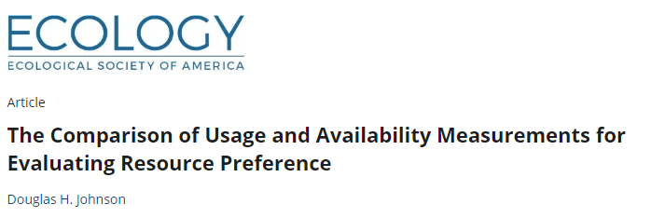
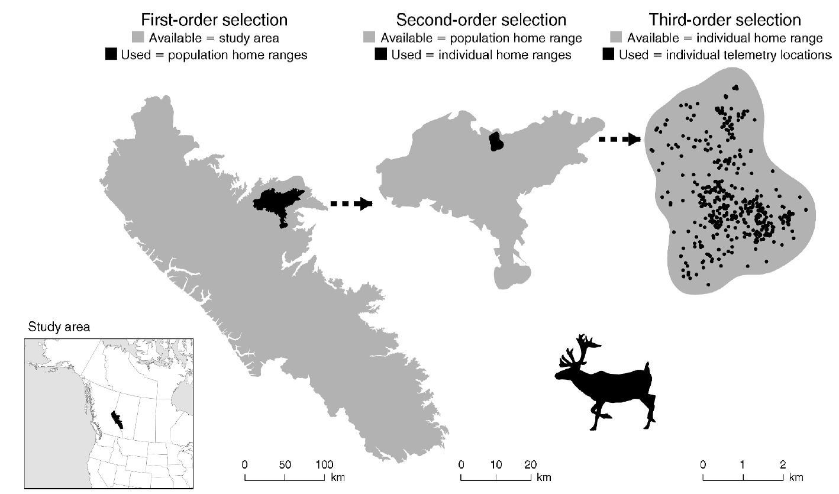
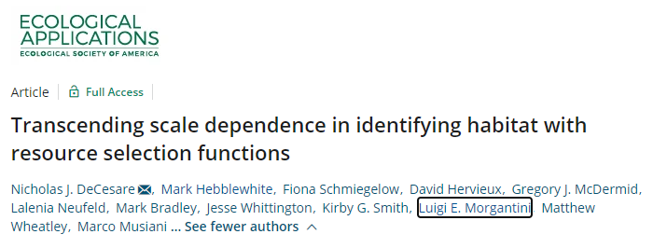
Orders of Selection
Different scales of inference
Fourth-order selection: Local habitat selection (individual steps)
Notes:
Before getting into analyses, we need to first take a step back and think about scale of our analyses. This has generally been discussed across three orders of selection, which I’m showing here. First order selection is generally described as population-level selection. So what does our population select in relation to what’s available on the landscape. What differentiates the habitat of this species from another. So a very broad scale.
Then, there’s second order selection, or more of a home range of our studied species. How does our species differ in its selection from those of the same species.
Then, there’s the individual home range selection. What does our individual animal select in relation to what’s available within its home range. This is generally the type of selection that’s most commonly conducted.
But, with the finer data that’s being collected, we can now start to look at the individual decisions that an animal makes along the period it was tracked, the individual choices, referred to as fourth order selection.

Slide 3
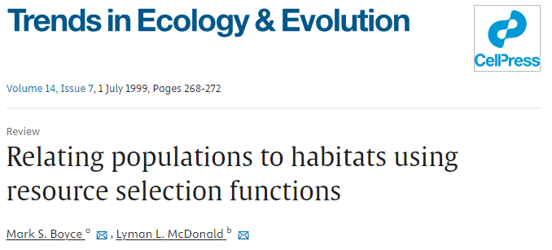
Resource Selection Function Modeling
Boyce and McDonald 1999. Relating populations to habitats using resource selection functions.
Compare environmental covariates at used locations to those at a set of locations assumed to be “available” to the animals
Perhaps better referred to as “Habitat Selection Functions” (HSFs)
Based on models for spatial point processes
Coefficients (and strength of selection) typically estimated with logistic regression models (binomial GLM)
These models approximate point process models under certain conditions
Notes:
RSFs have been a topic in ecology for about 20-30 year, dating back to this publication by Boyce and McDonald. At it’s most general, the modeling approach compares a set of environmental variables/covariates at used locations, based on our animal tracking data, to what is available to the animal. These are our background points that we must generate. These are pseudo absence points that in the RSF world, we refer to with the term “Availability”.
Differences between these sets of data are used to infer selection and our model estimates/coefficients help to assess the strength of that selection.
You’ll see some that use the term Habitat Selection rather than Resource Selection. This is meant to better reflect the wide range of environmental variables included in modeling, but the modeling process is the same. So, really it’s just a preference of terms used by different researchers.
Conceptually, the modeling approach is based on models for a spatial point process where the density of points on a surface is influenced by a set of spatial variables. We typically use logistic regression to estimate model coefficients that assess the strength of selection for these variables. These models are convenient because they are well developed in the field and they are shown to approximate point process models well.

Slide 4
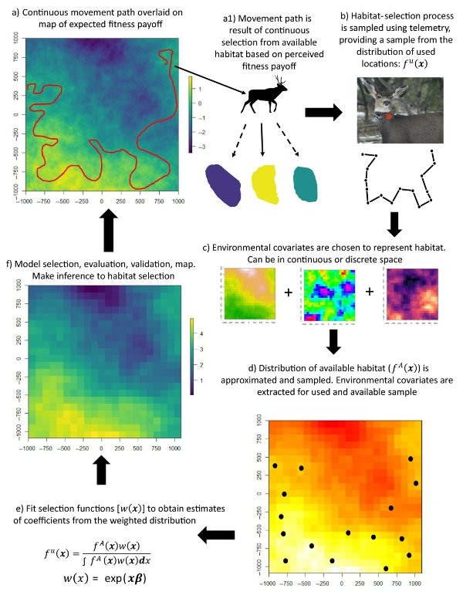

Identify habitat features preferentially used or avoided
Infer ecological needs and limitations
Generate expected distribution maps
Inform demographic projections in support of species/landscape management
Notes:
So let’s walk through the process, looking at a figure provided in a paper by Northrup. Our goal is to identify habitat features that are preferentially used or avoided by the species, with the goal of inferring or understanding ecological needs or limitations.
In many cases, researcher used the results from resource selection function models to generate expected distribution maps or relatively intensity maps (where the animal is located on the landscape), with the goal of informing species or landscape management.

Slide 5
Notes:
So let’s overview the process. What’s occurring in nature is a continuous process where the animal is moving across a changing landscape to maximize its fitness.

Slide 6
Notes:
The animal of course spends different amounts of time in each of these habitats, shown here in different colors.

Slide 7
Notes:
We sample that selection process by tracking individuals and sampling the larger unknown distribution of where this animal could have gone. This is represented here by showing the animals trajectory, which is really just a sample of our tracking period.

Slide 8
Notes:
We then choose a set of environmental covariates, either continuous or discrete, that we feel reflect the fitness landscape in which the animal is operating in.

Slide 9
Notes:
We then identify what we consider to be the available landscape that the animal had access to and we use our environmental covariates to describe our use and available distribution.

Slide 10
Notes:
We then fit a selection function, to get model coefficients which represent the strength of selection for our various covarites.

Slide 11
Notes:
Finally, we finish with model selection and evaluation to make a spatial prediction that prioritize which areas animal use more often compared to others.

Slide 12
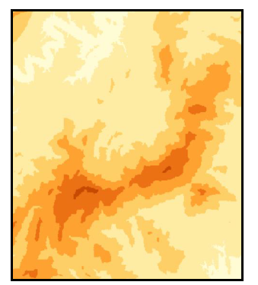
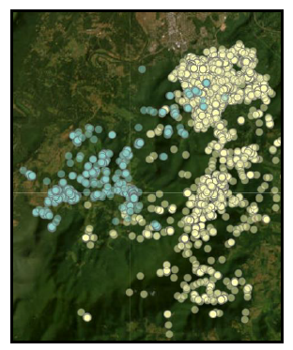
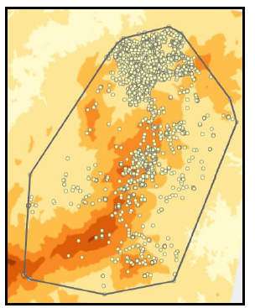
The Data
Environmental Covariates
Where to acquire?
How to represent variables?
Tracking Data (‘Use’)
Autocorrelation
Error and fix failure
Sample size of relocations AND animals
Availability
What defines the area?
How many locations are enough?
Random or Regular?
Notes:
The ingredients. In order to conduct an RSF, we need a few things. First, we need to think about the remote sensing variables that potential explain the preferences of our animal. Qianru described a number of different options for relating your animal point data. This process of creating your spatial dataframe can be a time consuming process and requires significant thought. It’s important to note, that you don’t need to solely rely on remote sensing data. You might, for instance, need a data that is specific to your study area, such as the locations or distance to small villages. This can be created and then incorporated in your analyses.
Then, there’s your tracking data. Some things to consider include autocorrelation of the tracking data, the potential error associated with your devices, and the appropriate sample size that you are using in your analyses.
And lastly, there’s defining your availability. This is generally done by creating a home range of that animal, but then there’s the question of how to make sure to appropriate sample from what is potentially available to the animal.

Slide 13
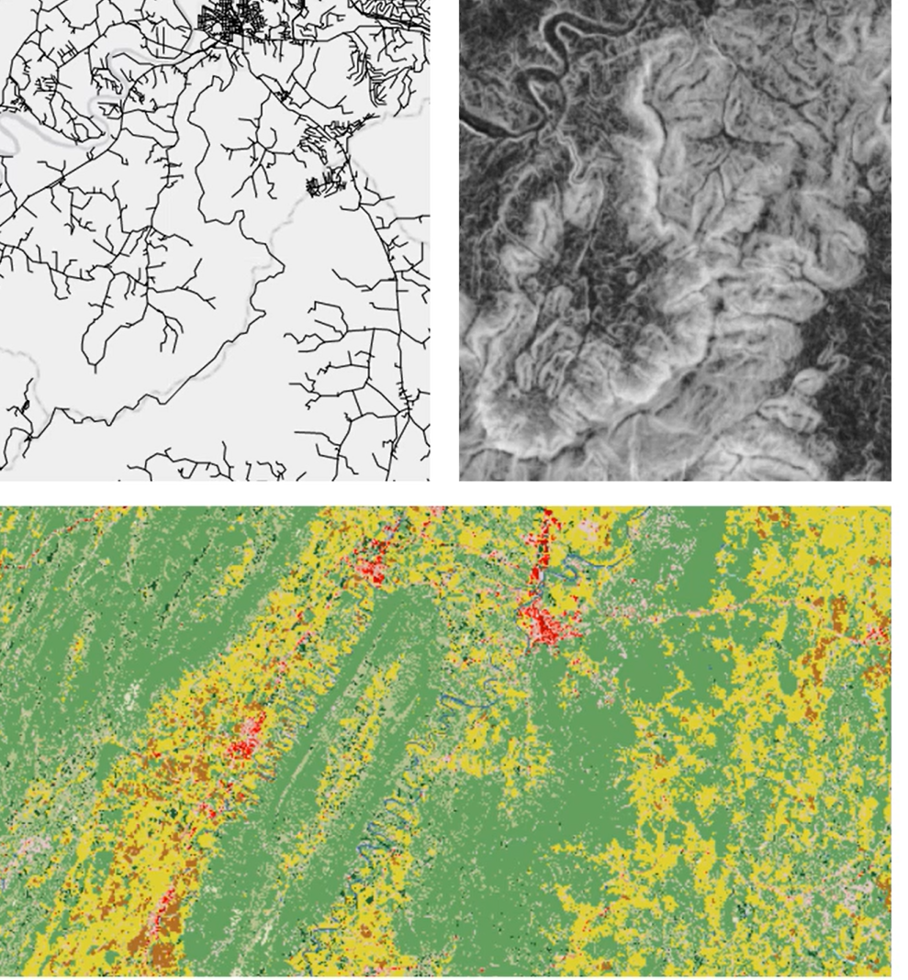
Characterizing the Habitat Landscape
Habitat distance vs Categorical variable
Interest in specific habitat type?
The role of error in assigning habitat type
Raster vs Vector
Existing format of available data
Desire to have all data sources in the same format
Required by some packages like amt and ctmm
Desire to create a prediction map
I prefer using only continuous raster layers, and would recommend using the reflectance values from a sensor rather than a classified value
Notes:
So just a few thoughts on characterizing the habitat landscape. We can include categorize our landscape using categorical or continuous variables. I generally try to only use continuous raster surfaces but that doesn’t mean you can’t incorporate a categorical variable, for instance a land cover classification. It’s important that the data you use are in the same format for analyses and ideally in raster formats. This then allows you to generate a predictive surface of your result, which that can be used in other applications or to predict how the habitat suitability might chance with a changing set of predictors.

Slide 14

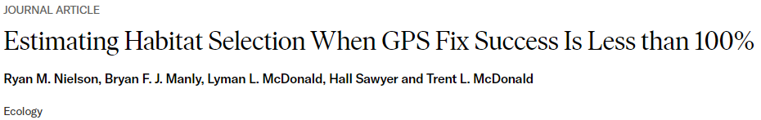
Tracking Data – Habitat-biased fix success
Reduced fix success rate in certain habitat can bias habitat modeling results
Solution 1: Correction factors may be developed and applied to GPS location data sets (Frair et al. 2004)
Calibration in multiple habitat types
Weights applied to recorded tracking data
Solution 2: Modeling habitat specific fix success probability (Nielson et al. 2009)
Similar to patch occupancy models
Fix success probability modelled separately from selection probability
Probability of detection Integrated Step Selection Function (PDiSSF; Vales et al. 2022)
PDiSSF package (Nielson and Lombardi 2022)

Slide 15
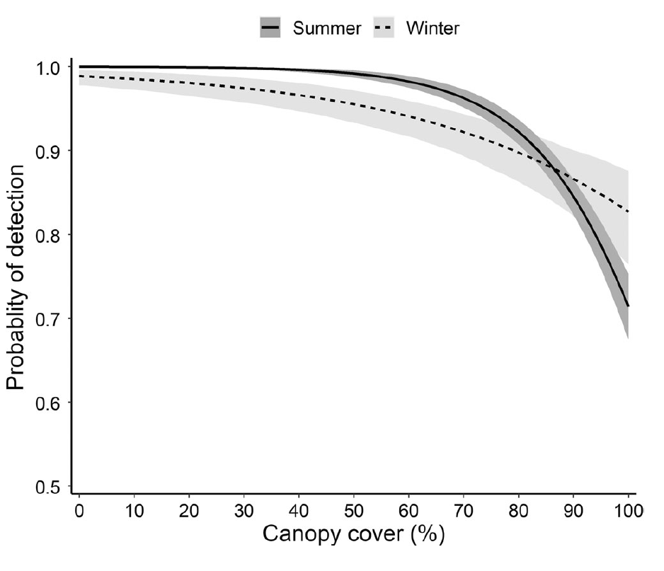
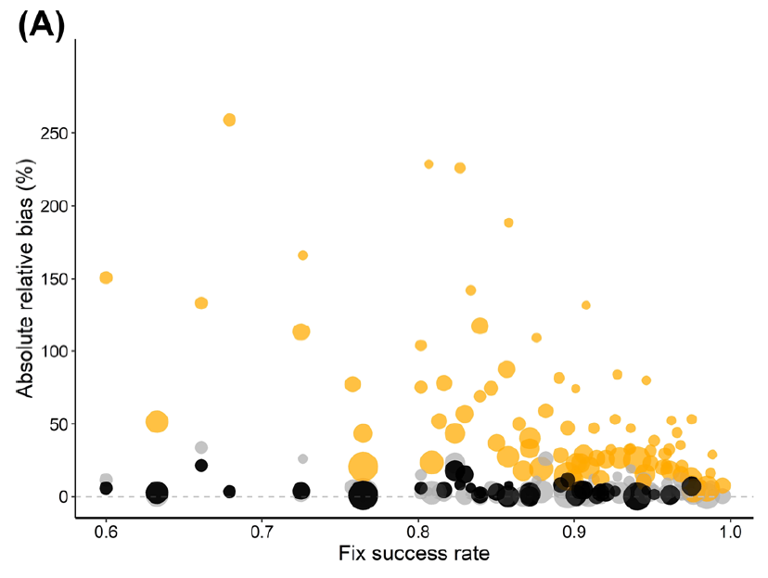

Notes:
You can see from the graph on the left, reported in Vales et al, that the probability of detection changes as the canopy cover increases. These are things that we recognize, since canopy and other features reduce the attenuation of the GPS signal. Importantly, we see that effect of canopy cover changes when comparing summer and winter periods.

Slide 16
Autocorrelation
Assumption of independent locations in standard RSF models
Will lead to underestimates of uncertainty/variance when data are autocorrelated
Potential solutions:
Thin data closer to improve independence
Use robust form of SE when describing uncertainty in population level parameters
Bootstrap method (Fieberg et al. 2020)
Newey West estimate (package: sandwich) – Nielsen et al. 2002
Ctmm::rsf.fit()
Step-selection functions to incorporate movement processes directly

Slide 17
Sampling Interval Regularity
Issue: Sampling interval influences inference – areas with higher sampling will appear more selected
Examples:
Differential day vs night sampling with differential day vs night habitat selection
Fix interval change later in season, when habitat selection has also changed
Solution:
Record at regular intervals or resample data to make the data ‘regular’
Notes:
The other issue that we want to think about is an irregular sampling interval. The problem with irregular samples is that areas that are sampled more frequently are likely to be over-represented in our dataset, thus biasing our result and effectively appearing like these areas are more selected than areas with lower sampling frequency. If this is happening completely randomly with respect to environmental variables, then it’s not a problem. But, for instance, we need to really understand if the pattern is random. For instance, you could have different sampling intervals between night and day, which could bias your results simply because you are collecting more points in day or night. Similarly, if you change fix interval while you are collecting data on your animals, it could result in greater preference for particular habitats and erroneously bias your regression coefficients.
The solution, of course, is to either collect data at regular intervals or resample your data to make the track regular, which is what we have done here with our wildebeest data.

Slide 18
How many relocations do I need per animal?
As many as possible
Assumed to be independent in RSF
Fewer locations needed when beta is high (strong selection)
BUT, if selection is VERY strong, highly specialized animal, may need a lot of more locations to observe at least SOME use of avoided habitats.
Some disagreement about relationship with landscape complexity
Street et al. 2021 find lower N needed with higher complexity
Notes:
One of the key questions to answer is that collecting as much data as possible, and more is better, while remembering that one of the key assumptions of our models are that data are independent. So, it’s not necessarily beneficial to collect more data if these data are more autocorelated if we can’t correct for this autocorrelation structure.
It’s generally been show that fewer locations
Complexity of the landscape also comes into play. Intuitively, this makes sense, since we’d need to appropriately sample from this complexity to get reliable inference. A recent paper, however, by Street et al….a paper which I’ve included in the publications folder found that lower sample sizes were needed, so some disagreement here.
There’s no real threshold for how much data should be collected. The most important point is adequately sampling the variability that exist across your study area.

Slide 19
Defining Availability – This is Critical
Critical decision point in RSF analyses
All habitat in available area must be truly available to the animal
Decision depends in part of desired inference from analysis
What area?
100% MCP – amt package
95% MCP
99% KDE (AKDE?)
Conduct sensitivity analysis with varying definitions of available area
Can likely defend decision based on behavioral ecology of the animal
Areas dependent on current location and movement behavior – SSF and variations
Notes:
Often, a simple MCP is used, mostly just because these are very quick to create. But should it be 100% or 95% MCP or 99% Kernel density estimate or perhaps a home range that has been calculated with CTMM. It’s important that any of these areas are not necessarily meant to provide an accurate depiction of an animals home range. Instead, this is just meant to provide a boundary to what is available to the animal and where we might want to sample.

Slide 20
How many available points do I need?
A lot and enough
Sufficiently large sample required to approximate a point process model
Sufficient size depends on animal, covariates, the ratio of use to availability…
• Computer time less limited than previously
• Current suggested approach:
Increase number of available points until estimated slope coefficients do not vary (Northrup et a. 2013; Fieberg et al. 2021)
Assign “infinite” weights to available points to reduce role of model specification (Fithian & Hastie, 2013)
• Regular or random points?
Regular likely better from a statistical sampling standpoint
Regular sampling one point per each raster unit an option (Street et al. 2021)
Notes:
Are seeing more recommendations for regular, versus random, sampling.

Slide 21
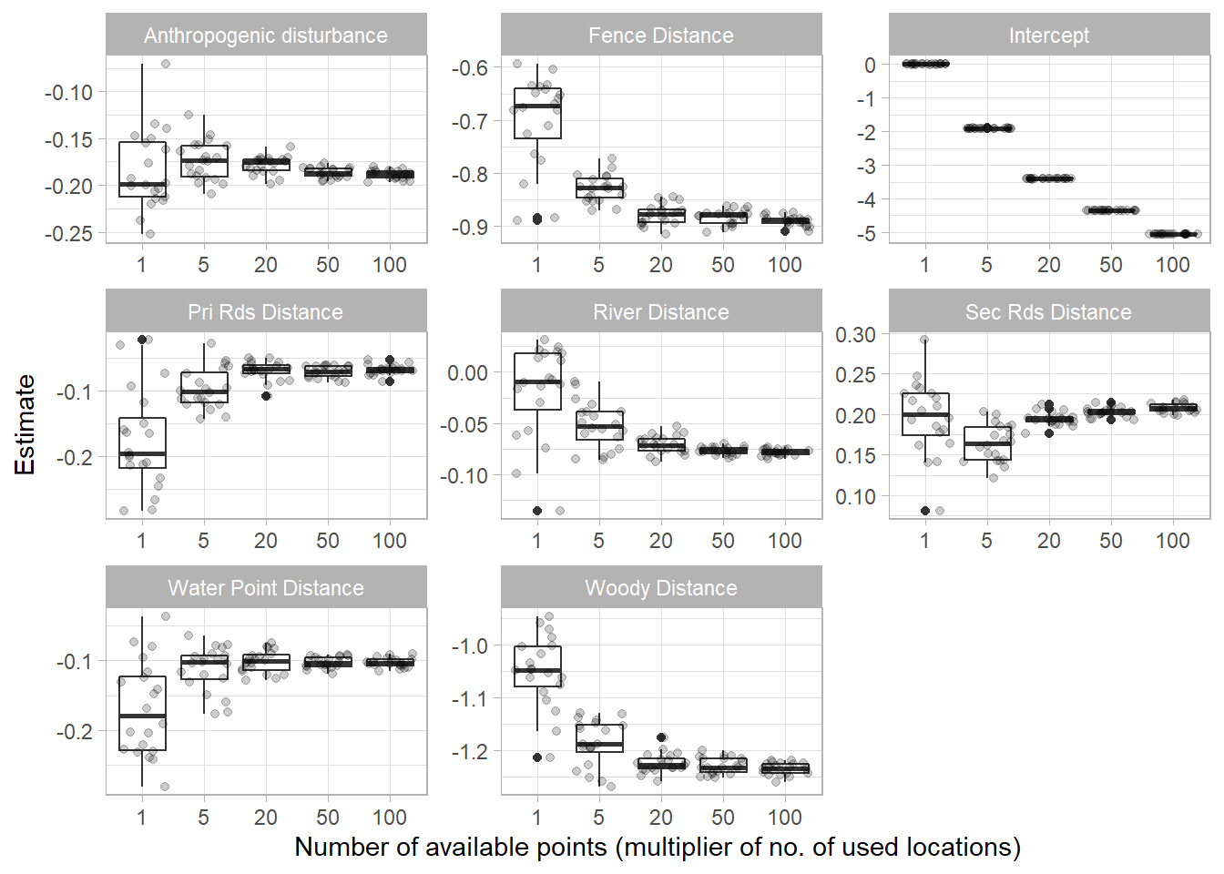

Grab graph of simulation
Grab graph of simulation

Slide 22
How many animals do I need?
Previous standard rule of thumb of > 30 (Leban et al. 2001)
Ignores the fact that many factors will influence selection strength, which determines required sample size
Landscape heterogeneity perhaps most critical
Street et al. 2021
Only declines with increase in Beta estimates (stronger selection patterns)
Depending on scenario, robust estimates may be feasible with lower samples than previously thought.
Analytical solution requires a priori knowledge of model coefficients and measure of landscape complexity (i.e., available area) as well as desired level of precision of estimates.

Slide 23
The modeling approach
Tracking (use) and random/regular locations (available) described well by a spatial Inhomogeneous Point Process (IPP) model
IPP is a model for random locations in space, where the expected spatial density of the locations depends on spatial predictors
The binomial likelihood of logistic regression differs from the conditional likelihood o the IPP model BUT
As the number of available points is increased towards infinity, the slope parameters in logistic regression models converge to the slope parameters in an IPP model (Warton and Shepherd 2010)
So we can use logistic regression! ….. Sort of…

Slide 24
Parameter Interpretation
Issue: Used and available locations not mutually exclusive (available habitat points may also be used)
Collected data is no longer a Bernoulli random variable
Ratio of used to available under control of the analyst as opposed to the process you are trying to describe
Probability of being a used point decreases with number of user-generated available locations
Solution: Modify our interpretation and application of logistic regression results

Slide 25
Changes from standard Logistic Regression
Interpretation of predicted probability inappropriate with use vs. available (not use vs. non-use, which would be a RSPF).
Intercept is biologicall meaningless
In IPP model it represents the baseline point density when covariates are = 0 (which is user determined with sampling intensity)
Focus on interpreting beta coefficients and resulting odds ratios as relative use intensity or relative probability of selection
Odds ratios termed Relative Selection Strength (RSS)

Slide 26
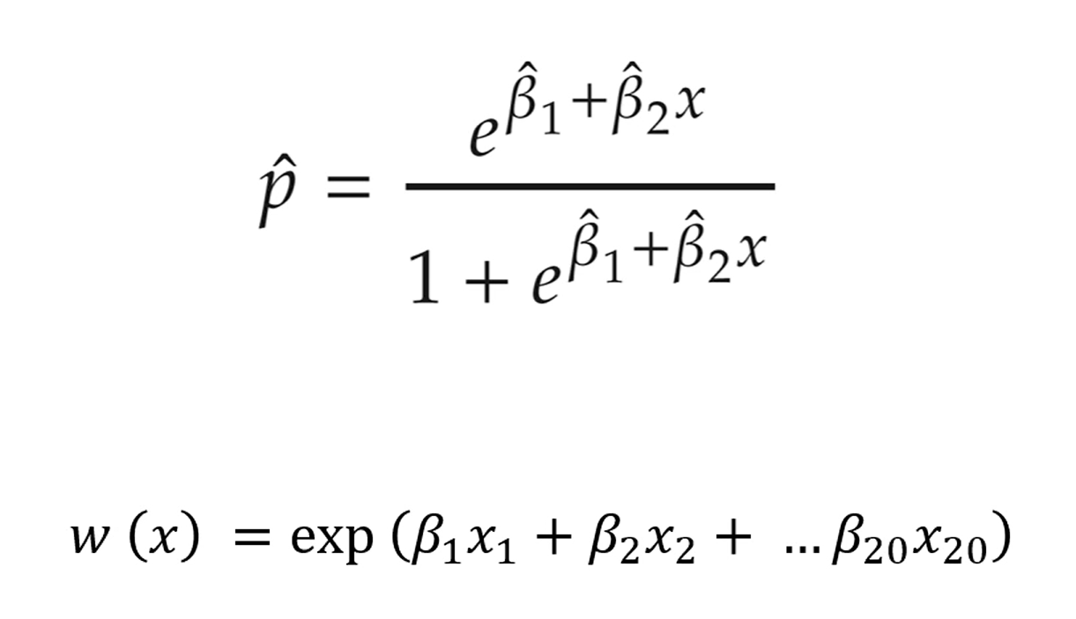

Slide 27
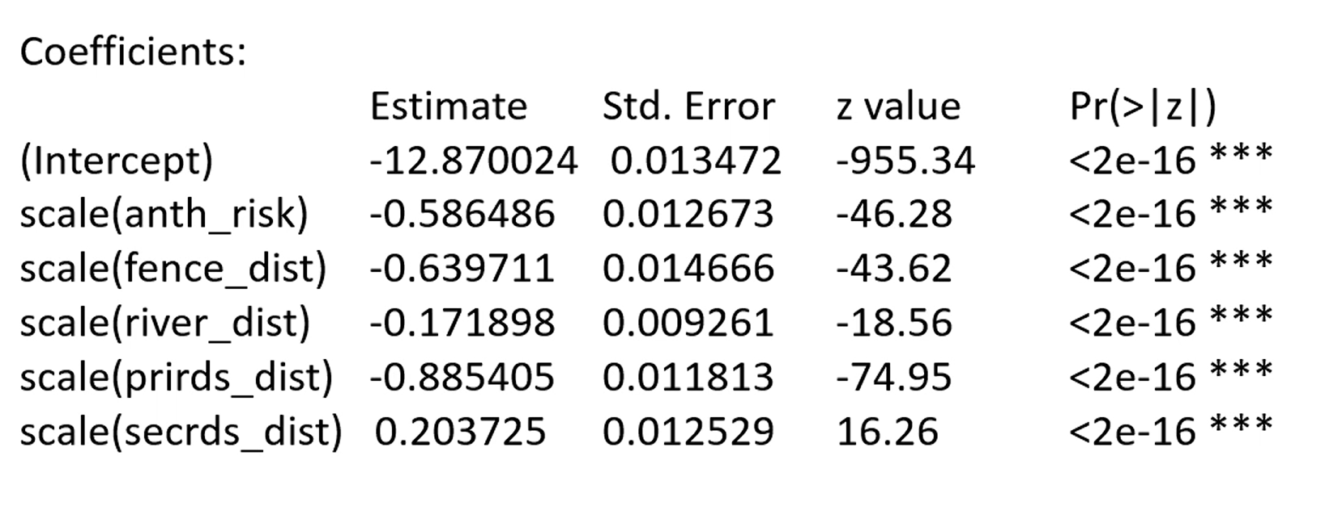

Slide 28
Interpreting Parameters
Odds ratio interpreted as relative selective strength (RSS) – Avgar et al. 2017
Relative intensity of use of two locations that differ by 1 unit of covariate (1 SD if covariates were scaled)
exp(β)
exp(0.303) = 1.35
“animal is 1.35 times more likely to choose location with 1 unit higher of this covariate”
exp(-0.183) = 0.833
“0.833 times more likely to choose a location with 1 higher value of covariate”
OR
exp(0.183) = 1.20
“1.20 times more likely to choose location with 1 lower value of covariate”
Different values assumed to be equally available and values for all other predictors are held constant

Slide 29
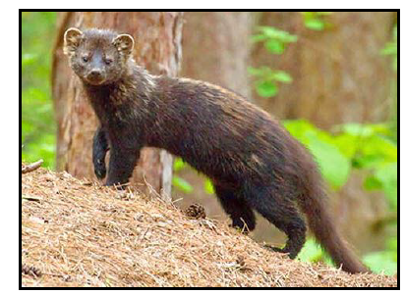
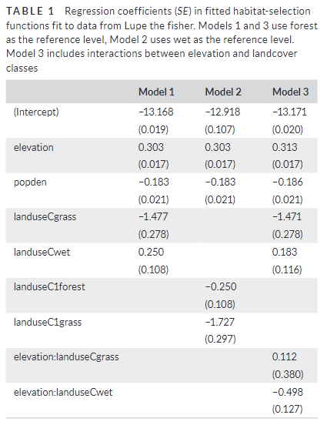
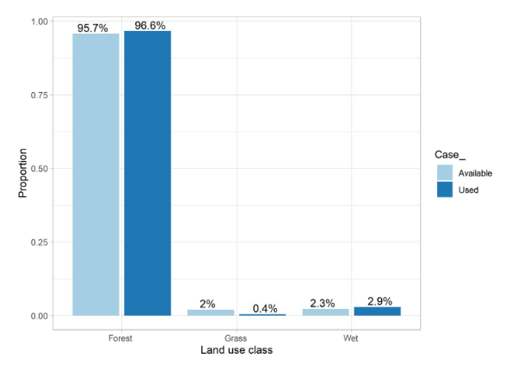
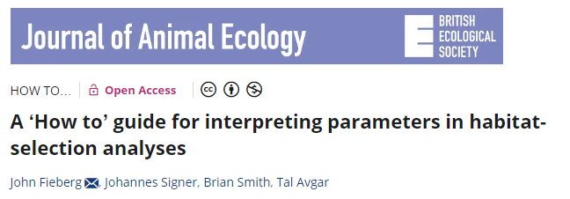
Categorical Parameters
Plots of use vs availability frequency distributions
Remember baseline category assignment
exp(0.250) = 1.28
1.28 * 0.023/9.957) = 0.03
1/0.03 = 33 times more likely to find an animal in forest than wetland

Slide 30
Model Selection
Multicollinearity should be addressed prior to model fitting
Variance inflation factor (VIF > 3.0)
Pairwise correlations (> 0.7)
Model parsimony not typically an issue and most complicated models often selected
Inference typically made from “full/global” model estimates and associated uncertainty
Model sets compared with information theoretic approaches (e.g., AIC) and similar metrics when necessary
E.g., testing polynomials or interactions, comparing utility of correlated predictors

Slide 31
Individual vs Pooled vs Random Effects
Pooled data across individuals
Available points within animal ranges pooled
One set of models
RSF fit to each individual (Two-stage approach)
Individual inference possible and individual variability assessed
Coefficients average across individuals for population-level assessment
Generalized linear mixed effects models
Individual as a random effect in global model
Random slopes most informative option

